Slide 1
Data Structures and Algorithms
LECTURE 04: RECURSION

Slide 2
Objectives
Recursive definition
Method calls and recursion implementation
Anatomy of a recursive call
Tail recursion
Non-tail recursion
Indirect recursion (*)
Nested recursion (*)
Excessive recursion
Backtracking (*)
Reading at home
Notes:
(*) Means that students are required to understand essential features only (the problem explaination, definitions, the outline of algorithms…), not in details.

Slide 3
Recursion definitions and examples
Definitions, convert to binary, and factorial examples

Slide 4
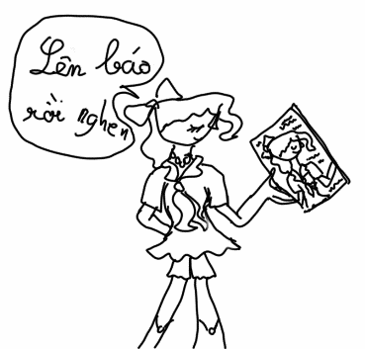
Recursive definition
Recursive definition or inductive definition
Defining something in term of itself
For it to work, the definition must
Well-founded
Avoid infinite regress
It consists of at least two parts
Base case (ground case) that doesn’t reference to itself
Inductive case contains a reference to its own type
public class Node {
int info;
Node next;
…
}
?

Slide 5
Recursive definitions
BASIC STEP: Specify the value of the function at zero.
RECURSIVE STEP: Give a rule for finding its value at an integer from its values at smaller integers.
Example: f: Z → Z⁺
f(0) = 0, f(1) = 1
f(n + 1) = f(n) + f(n-1)
Find f(1), f(2), f(3)?

Slide 6
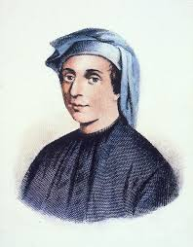
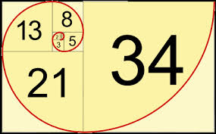
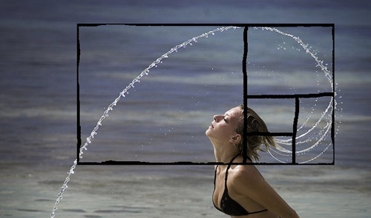
Fibonacci numbers
Fibonacci numbers definition:
f(0) = 0, f(1) = 1
f(n) = f(n-1) + f(n-2)
Example: 0, 1, 1, 2, 3, 5, 8, …
Golden ratio definition:
ϕ = 1 + 1/ϕ
Fibonacci applications in programming:
pseudo random number generators.
merge sort algorithm
heap data structure
search technique
Notes:
application: architecture (spiral stairs), photography
sun-flower
ϕ - phi

Slide 7
Exercises
Give recursive definitions of:
n!
2^{n}
1 + 2 + … + n
F(1) = 1
F(n) = n * F(n-1)
F(0) = 1
F(n) = 2 * F(n-1)
F(1) = 1
F(n) = n + F(n-1)

Slide 8
Recursive program/algorithm
Recursive program/algorithm is one that calls itself
There are three basic rules for developing recursive algorithms
Know how and when to stop
Know how to take one step
Break each problem down into one step plus a smaller problem

Slide 9
Recursive algorithm & recursive definition
int power5th(int n)
{
if (n == 0) return 1;
return power5th(n-1) * 5;
}
f(n): Z⁺ → Z⁺, f(n) = 5^{n}
Basic step: n = 0 , f(0) = 1
Recursive step: f(n) = f(n-1) * 5

Slide 10
Convert to binary example
/2
/2
/2
/2
Stop
10
5
2
1
0
%2
%2
%2
%2
0
1
0
1
return
return
return
return
print
print
print
print
0
1
0
1
Values
2⁰
2¹
2²
2³
What is basic step?
What is recursive step?

Slide 11
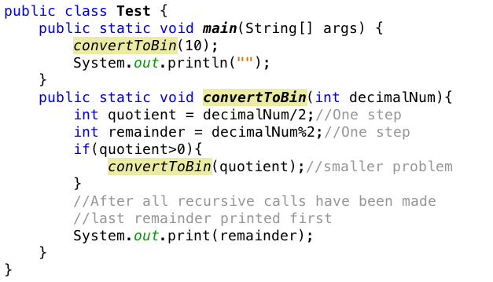
Convert to binary example

Slide 12
Recursion application
Recursive definitions are used in defining functions or sequences of elements
Purpose of data recursive definition
Generating new elements
Testing whether an element belongs to a set (*)
(*) The problem is solved by reducing it to a simpler problem

Slide 13
Method calls and recursion implementation

Slide 14
How does recursion actually work?
Each time a method is called, an activation record (AR) is allocated for it.
This record contains the following information
Parameters and local variables used in the called method
Dynamic link: a pointer to the caller’s activation record
Return address to resume control by the caller (address of instruction immediately following the call)
Return value for a method not declared as void.
Since the size of AR may vary from one call to another, returned value is placed right above the AR of the caller

Slide 15
How does recursion actually work?
Each new AR is placed on top of the run-time stack
When a method terminates, its AR is removed from the top of the run-time stack
Thus, the first AR placed on the stack is the last one removed.

Slide 16
Creating an activation record
Creating an activation record
Whenever a method is called
Allows system to handle recursion properly
Recursion is calling a method that happens to have the same name as the caller
Recursive call is not literally calling itself
These invocations are presented internally by different activation records

Slide 17
Direct recursion
Tail recursion, Non-tail recursion

Slide 18
Tail vs non-tail recursion
A recursive function is tail recursive when recursive call is the last thing executed by the function
The tail recursive functions considered better than non tail recursive functions as tail-recursion can be optimized by compiler.

Slide 19
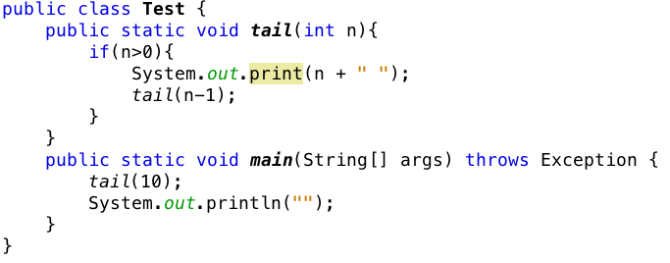
Tail recursion
There is only one recursive call at the very end of a method implementation.

Slide 20
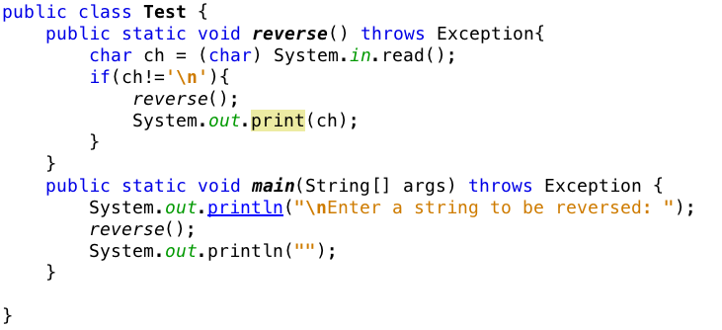
Non-tail recursion
? convertToBinary is tail or non-tail recursive function?
The recursive call not at every end of a method implementation

Slide 21
Indirect recursion
If f() calls itself, it is direct recursive
If f() calls g(), and g() calls f(). It is indirect recursion
The chain of intermediate calls can be of an arbitrary length
f() -> f1() -> f2() -> … -> f(n) -> f()

Slide 22

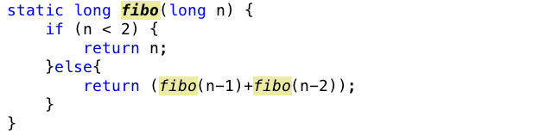
Excessive recursion
Consider Fibonacci sequence of numbers
This looks very natural but is very inefficient implementation

Slide 23
Tree calls of fibo
fib(4)
fib(3)
fib(2)
fib(1)
fib(0)
fib(2)
fib(1)
1
0
fib(1)
fib(0)
1
1
0

Slide 24
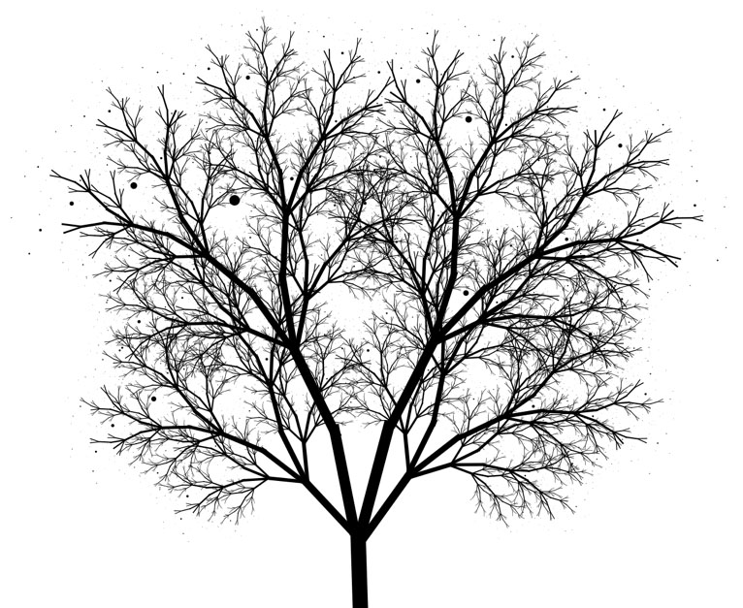
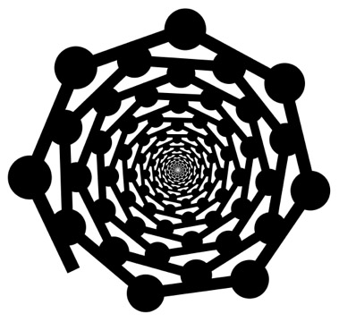
Drawing fractals

Slide 25
RECURSIVE Characteristics
Recursive vs. Iteration, Back tracking

Slide 26
Recursion vs. Iteration
Some recursive algorithms can also be easily implemented with loops
When possible, it is usually better to use iteration
Since we don’t have the overhead of run-time stack
Other recursive algorithms are very difficult to do any other way

Slide 27
Back tracking
In solving some problems
There are different ways leading from a given position
None of them known to lead to a solution.
After trying one path unsuccessfully
Return to this crossroad and
Try to find a solution using another path.
We must ensure
Such a return is possible and
All paths can be tried.
Technique is called backtracking.
This technique is used in artificial intelligence
One of the problem which backtracking is very useful is the n-queens problem

Slide 28
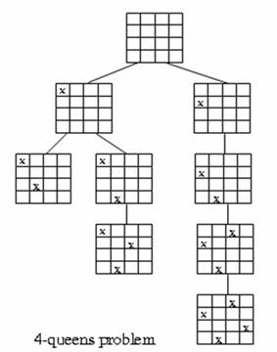
4-queens problem
Each choice leads to another set of choices.
Make one choice and continue.
If you reach a dead end, go back to previous choice and try next alternative.

Slide 29
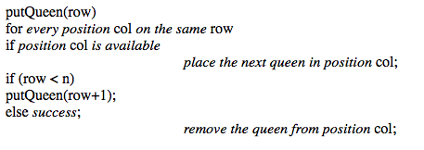
4-queens problem

Slide 30
Summaries
Recursive definition
Method calls and recursion implementation
Anatomy of a recursive call
Tail recursion
Non-tail recursion
Indirect recursion (*)
Nested recursion (*)
Excessive recursion
Backtracking (*)
Reading at home
Notes:
(*) Means that students are required to understand essential features only (the problem explanation, definitions, the outline of algorithms…), not in details.

Slide 31
The end

